Slide 1

Automate API Testing

Slide 2

Tonight’s Agenda
Introduction to Ply
Ply Demo
Questions/Ideas

Slide 3
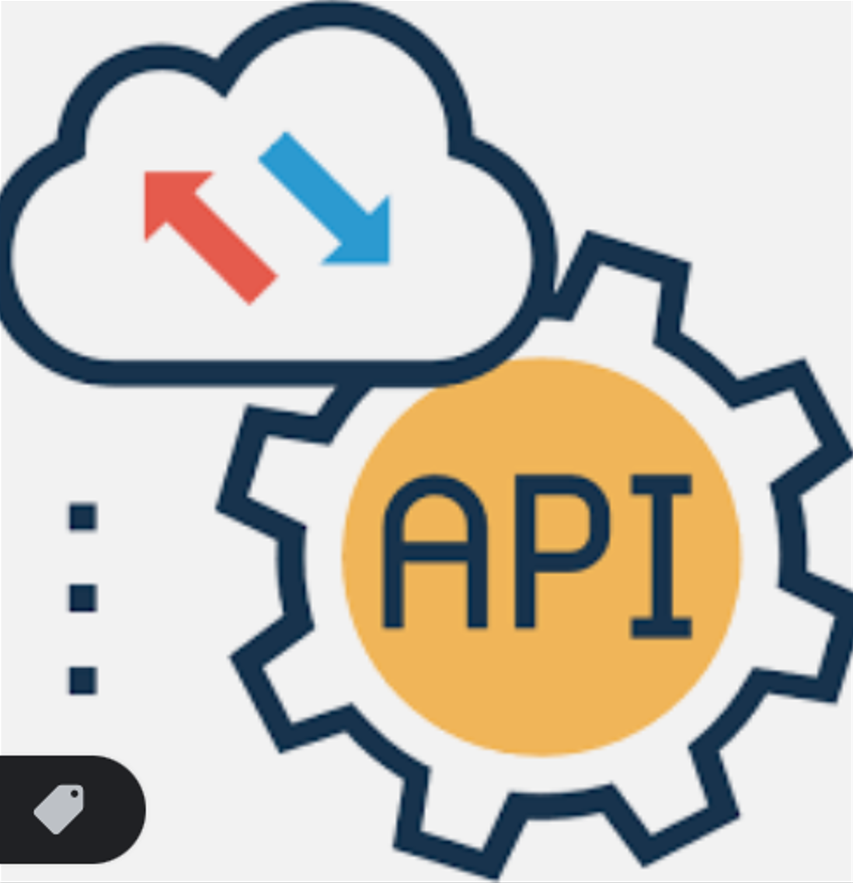
The Rise of APIs
Use in Enterprise Web Apps
Direct Access: External Users
AI & ML
Testing Needs!

Slide 4
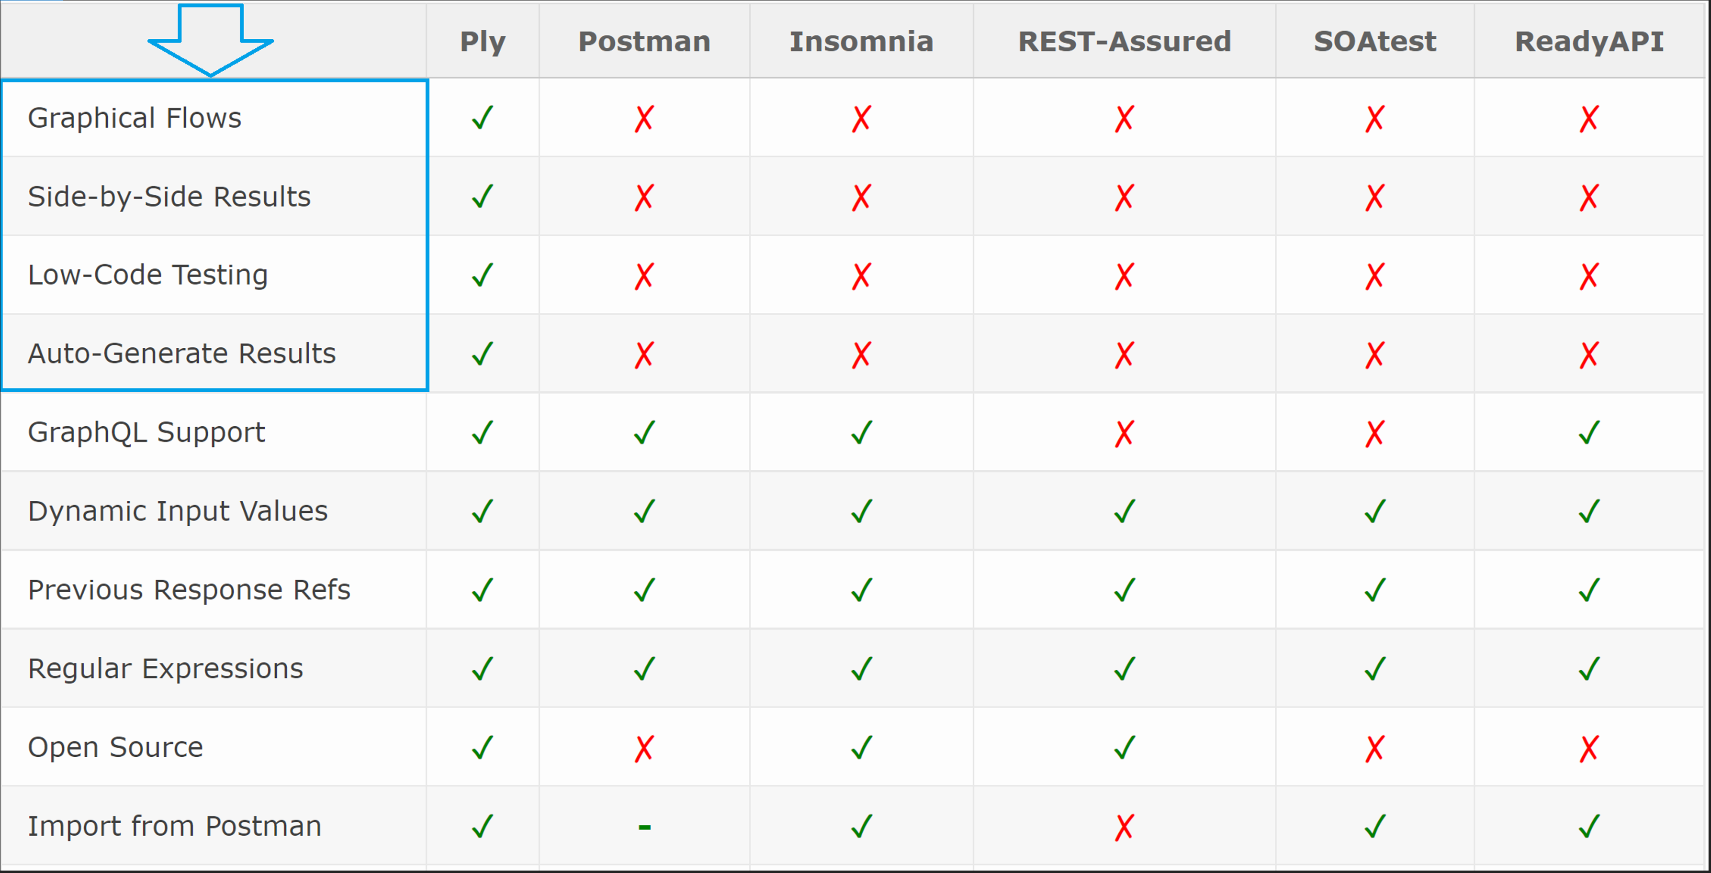
API Testing Tools: Capabilities

Slide 5
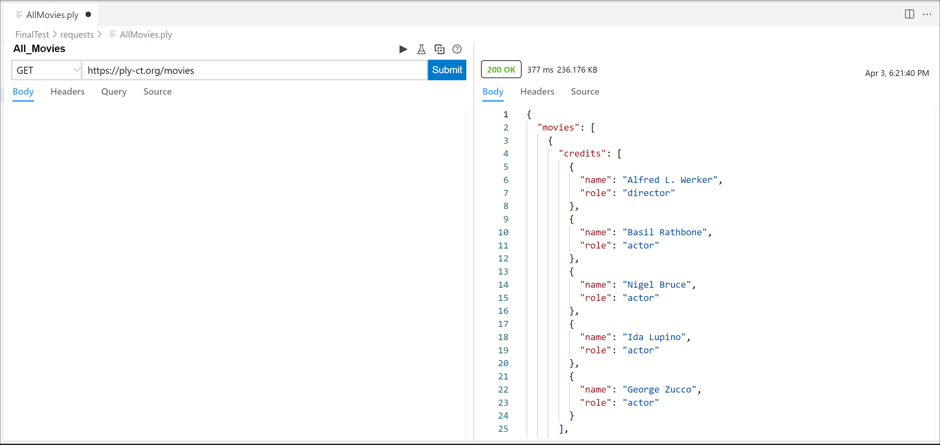
Ply: Requests

Slide 6
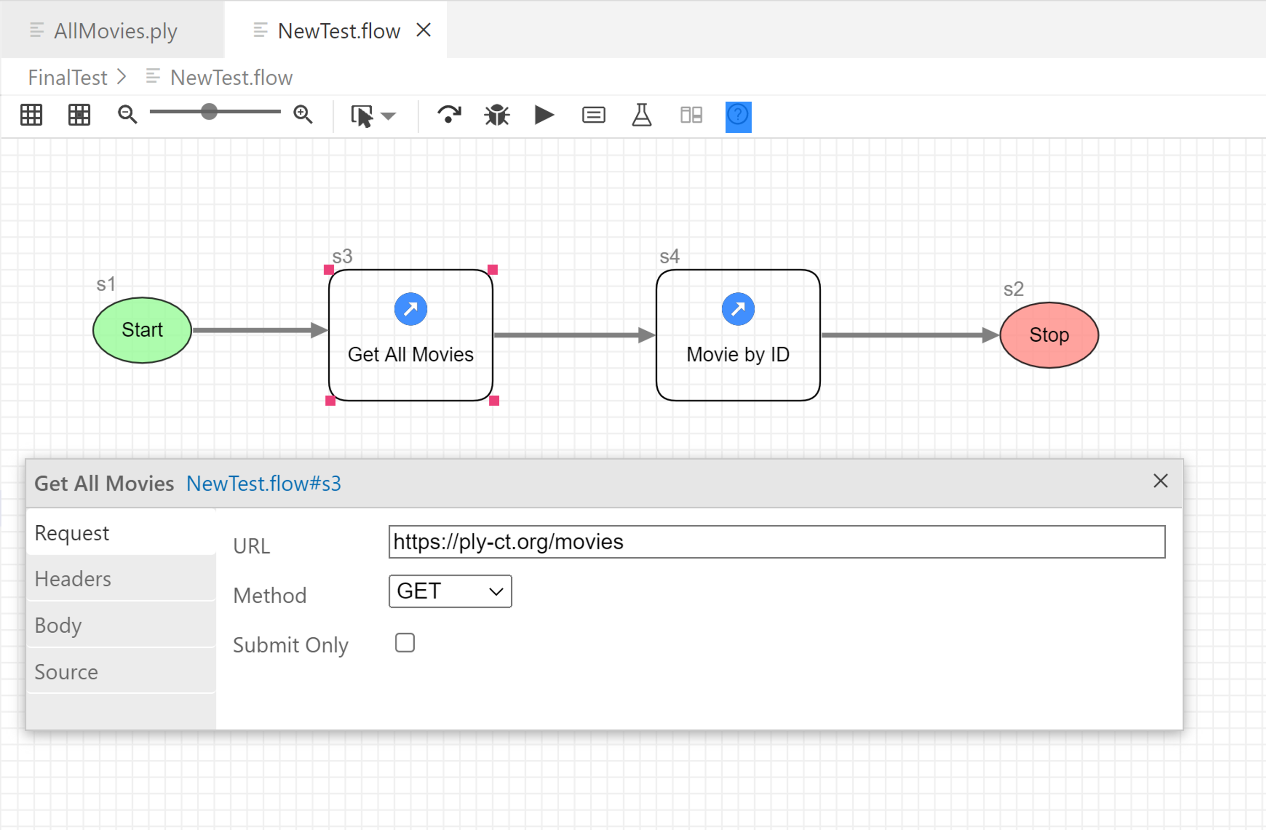
Ply: Flows

Slide 7
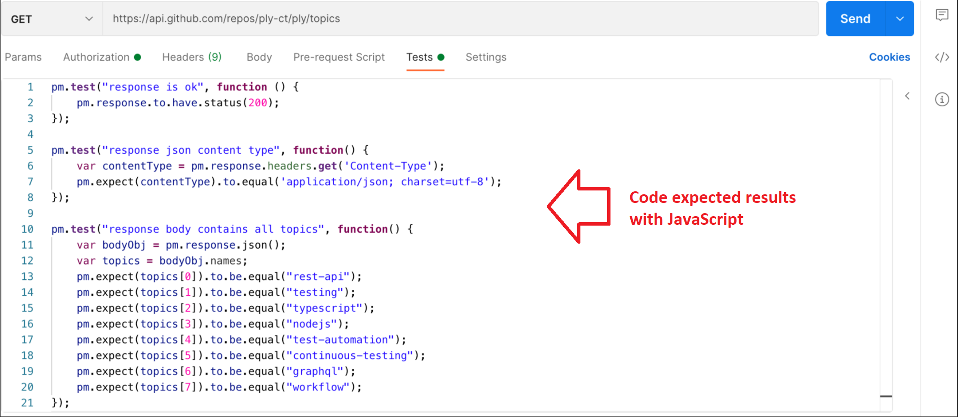
Create Expected Results: Other Tools

Slide 8
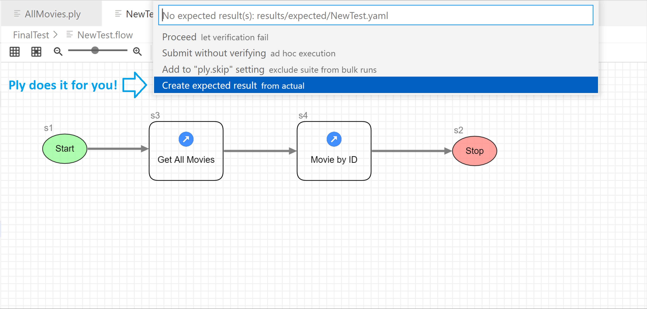
Create Expected Results: Ply

Slide 9
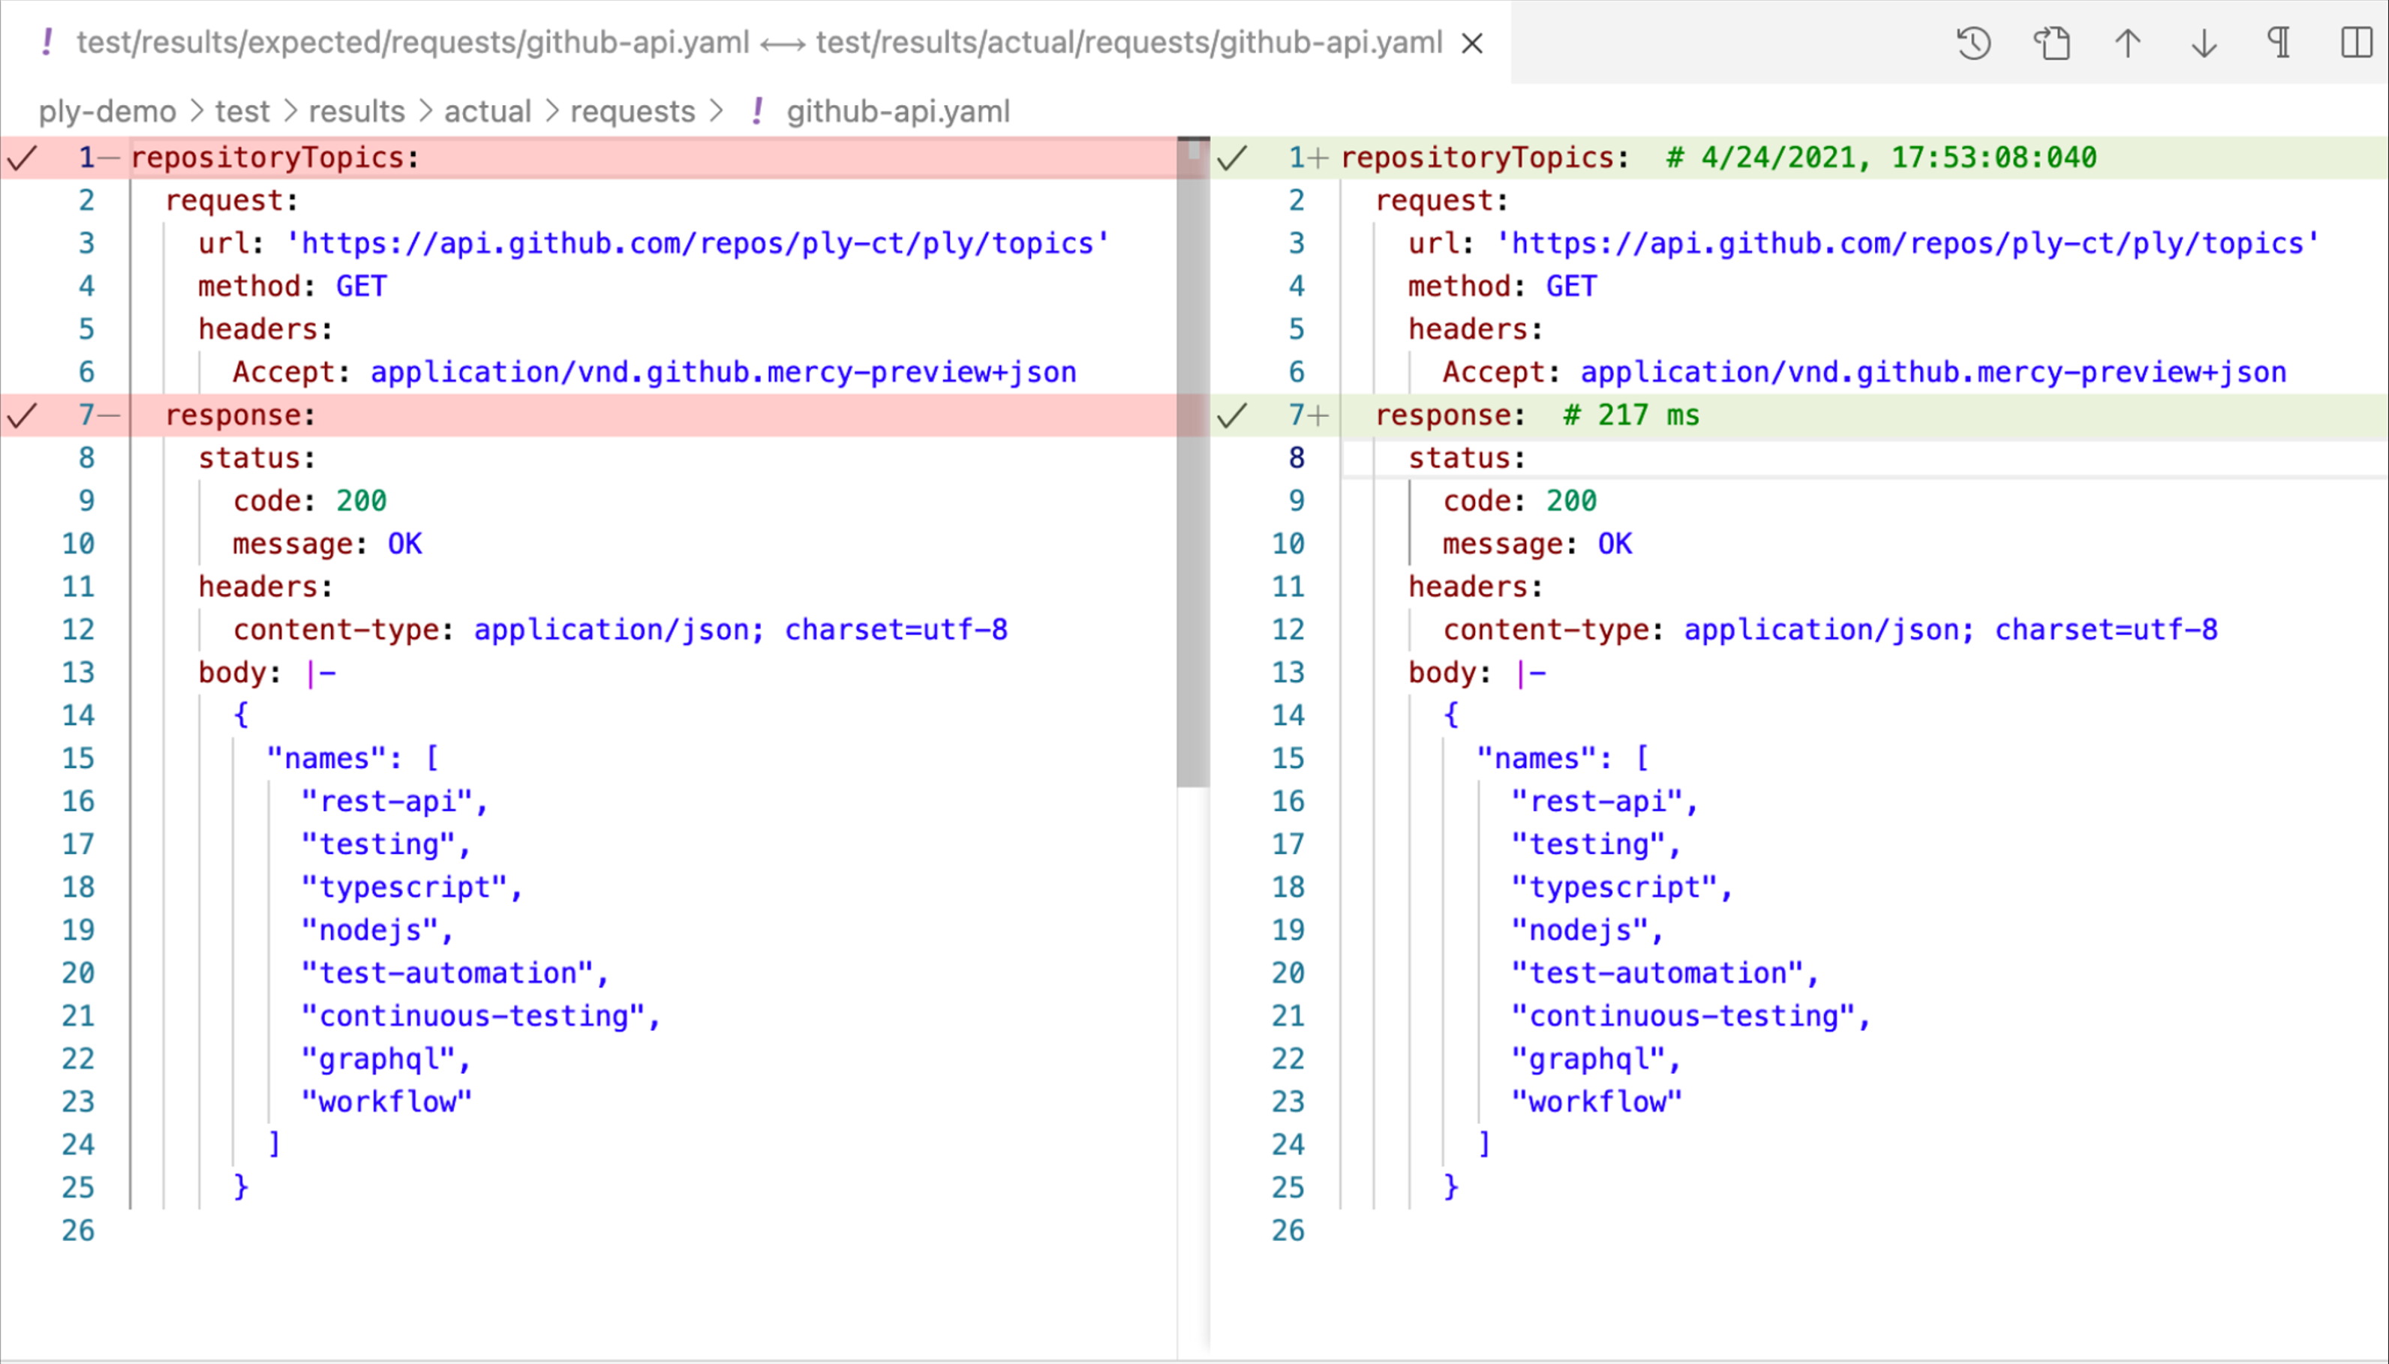
Ply: Compare Results

Slide 10

Ply: A few more odds & ends
Supports REST & GraphQL
VS-Code Extension
Load Testing (Excel, CSV files)
Parameterize Values
Advanced Steps: ‘TypeScript’, ‘Decide’
Run from Command Line (CI/CD Pipeline)

Slide 11
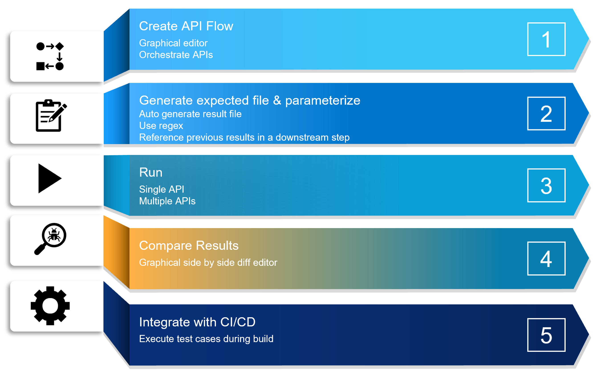
Ply Demo

